Slide 1
CMPE493 Term Project Presentation
Onur Can Avcı
Erencan Uysal
Muhammed Göktepe

Slide 2
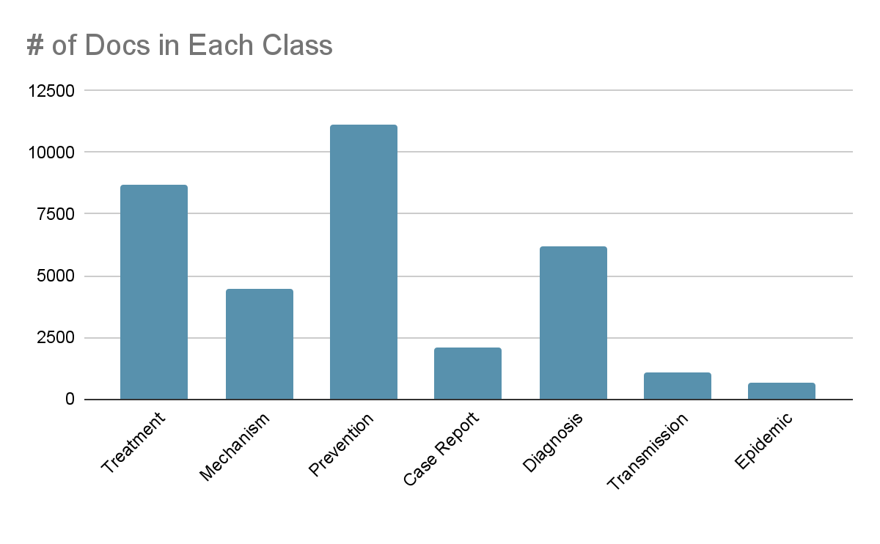
General Status
We have a large dataset and it contains thousands of words.
We used meaningful parts of the dataset such as title, abstract and keyword parts of documents to classify them correctly.
There are seven different classes in the LitCovid dataset.

Slide 3
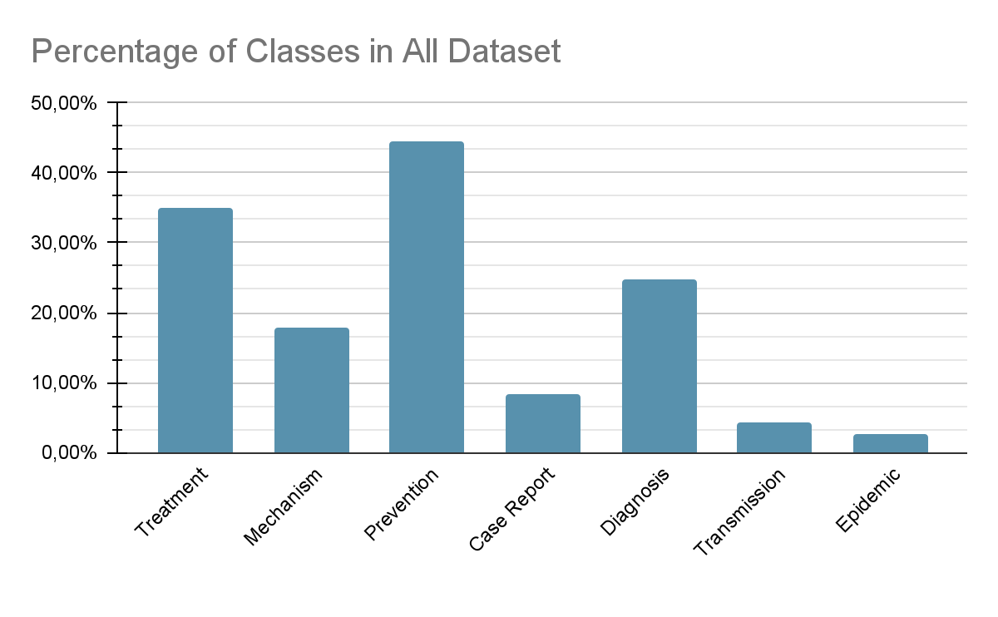
General Status
As you can see from the graph almost half of the documents are labels as Prevention and Treatment. These are the dominant classes.

Slide 4
Preprocessing and Stopword Removal
Words like “I, on, that, at” are very common and it will not have much effect on text classification. So we removed words like these from our dataset.
We preprocessed our data with custom preprocessor.
Preprocessor algorithm works as the following:
lowercase the text
removal of special characters
stemming the words using Porter Stemmer

Slide 5
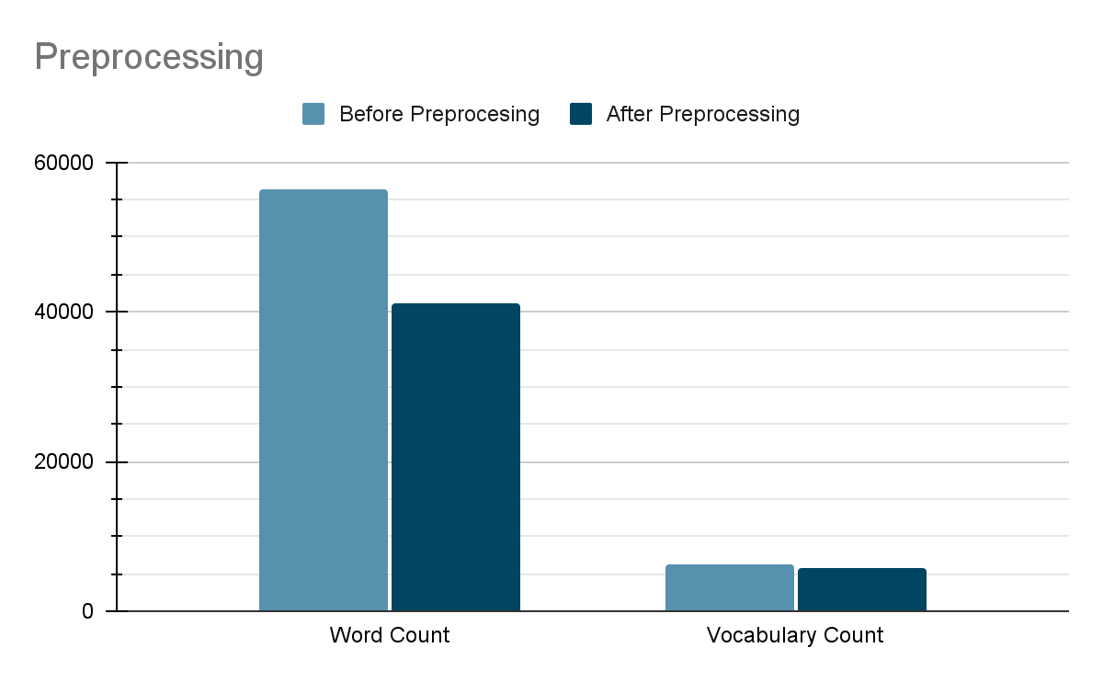
Preprocessing and Stopword Removal
Before preprocess data there are 56502 tokens and 6284 terms in our dataset.
After Preprocessing there are 41190 tokens and 5750 terms in our dataset.

Slide 6
Libraries and Functions
We used CountVectorizer and TfidfTransformer components from sklearn.feature_extraction.text library.
We trained our model by providing preprocessor function and stopword list to these components.
These components are working efficiently and gives results faster.
CountVectorizer;
Converts a collection of text documents to a matrix of token counts.
This implementation produces a sparse representation of the counts using scipy.sparse.csr_matrix.

Slide 7
Baseline Approach
We used scikit-learn tools to create and train our model.
Initially we used naïve Bayes classifier.
We also implemented a classifier from scratch but in order to show clear statistics, we will use scikit-learn results.
The Naive Bayes classifier is a simple classifier that classifies based on probabilities of events.
It is the applied commonly to text classification.
Though it is a simple algorithm, it performs well in many text classification problems.

Slide 8

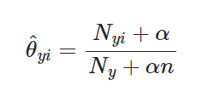

Multinomial Naïve Bayes
MultinomialNB implements the naive Bayes algorithm for multinomial distributed data.
We used tf-idf vectors to represent our data. So multinomial NB was one of the best fitting algorithms for our needs.
This method uses relative frequency counting which was also mentioned in our lectures.
The distribution is parametrized by vectors for each class y, where n is the number of features (the size of the vocabulary) and theta is the probability.
Relative frequency counting:
is the number of times feature i appears in a sample of class y in the training set

Slide 9
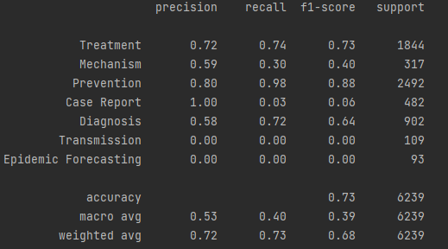
Evaluation of Results
We used development dataset for testing.
These results are the success rates of our classification for development dataset.
In development dataset we made same preprocessing and stopword removal as we did in training data.

Slide 10
Evaluation of Results
The precision is the ratio tp / (tp + fp) where tp is the number of true positives and fp the number of false positives. The precision is intuitively the ability of the classifier not to label as positive a sample that is negative.
The recall is the ratio tp / (tp + fn) where tp is the number of true positives and fn the number of false negatives. The recall is intuitively the ability of the classifier to find all the positive samples.

Slide 11
Evaluation of Results
The F-beta score can be interpreted as a weighted harmonic mean of the precision and recall, where an F-beta score reaches its best value at 1 and worst score at 0.
The support is the number of occurrences of each class in y_true.

Slide 12
Evaluation of Results
Case Report, Transmission and Epidemic Forecasting classes can not classified correctly.
You can see that their recall rates are very low.
Number of documents in these classes are considerably low. This situation results in misclassification.
Weighted average of recall rate is sufficiently higher because other classes have more documents and they are classified correctly.

Slide 13
Visualization
In the training step, we created a sparse matrix with shape of (34246, 41189).
It was impossible to visualize this kind of matrix.
We used dimension reduction to visualize this document vectors. However, it requires giant amount of ram. So we divided our dataset and visualize a part of it (4000 documents).
We used sklearn.decomposition to make this reduction.

Slide 14
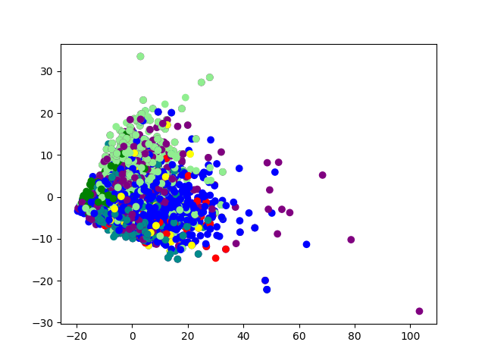
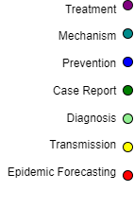
Dataset With Original Labels

Slide 15
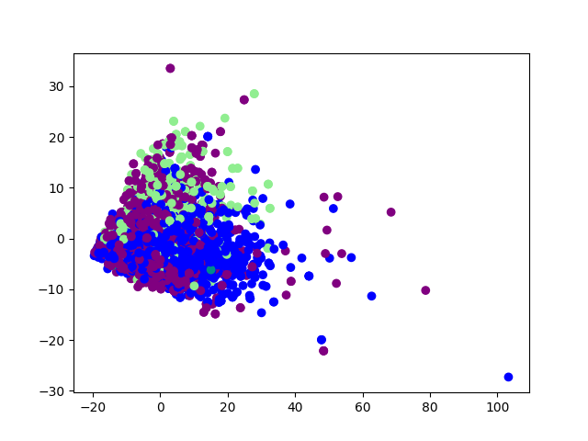

Dataset With Our Classification

Slide 16
Challenges
'Transmission', ‘Case Report’ and 'Epidemic Forecasting' classes contain very little data compared to others.
This situation resulted in underfitting for these classes.
As you can see from graphs, our trained model can not detect these classes properly.
Documents which originally belong to these classes can be misclassified and labeled with other class names.
We used Support Vector Machine to overcome this problem.

Slide 17
Support Vector Machine
In machine learning, support-vector machines are supervised learning models with associated learning algorithms that analyze data for classification and regression analysis.
After MultinomialNB, we used SVM to increase our success rates.
With the help of the SVM, we tried to classify 'Transmission', ‘Case Report’ and 'Epidemic Forecasting' classes properly.
SVM maps training examples to points in space so as to maximise the width of the gap between the two categories. New examples are then mapped into that same space and predicted to belong to a category based on which side of the gap they fall.
Advantages of SVM:
Effective in high dimensional spaces.
Uses a subset of training points in the decision function (called support vectors), so it is also memory efficient.

Slide 18
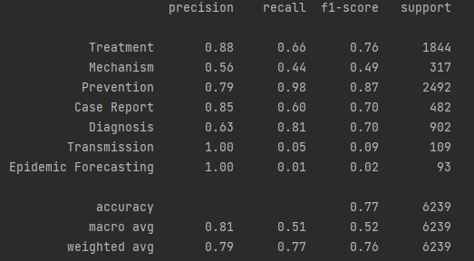
Evaluation of Results After SVM
The recall score for Case Report increased noticeably after SVM.
Transmission and Epidemic Forecasting also increased but it is not in a desired level.
It is clear that the macro and weighted average calculations also increased after improvements in recall and f1-score.
As we can see in two pictures precision and recall are also increased. It shows that SVM classifies more correctly.

Slide 19
Future Plans
We had some problem with classifying ‘Transmission’ and 'Epidemic Forecasting' classes.
We will improve our methodology and try to increase our success rates in these classes.
We are using vectorized features. We will try to use non-tokenized features.
We will implement another classification algorithm like K-means.
We will improve preprocessing in order to detect edge features of underfitting classes.
We will try to improve implementation of naive Bayes method.
We will compare the results with previous work.

Slide 20
References
https://scikit-learn.org/stable/modules/generated/sklearn.feature_extraction.text.CountVectorizer.html#sklearn.feature_extraction.text.CountVectorizer
https://medium.com/analytics-vidhya/naive-bayes-classifier-for-text-classification-556fabaf252b
https://scikit-learn.org/stable/modules/naive_bayes.html#naive-bayes
https://scikit-learn.org/stable/tutorial/text_analytics/working_with_text_data.html
https://kavita-ganesan.com/how-to-use-countvectorizer/#.YcwF_vBByUl
https://scikit-learn.org/stable/modules/svm.html#svm
https://towardsdatascience.com/support-vector-machine-introduction-to-machine-learning-algorithms-934a444fca47

